Slide 1
GPP Exam: Zombie AI
Delete all comments after reading
You are not allowed to add more slides to this presentation

Slide 2
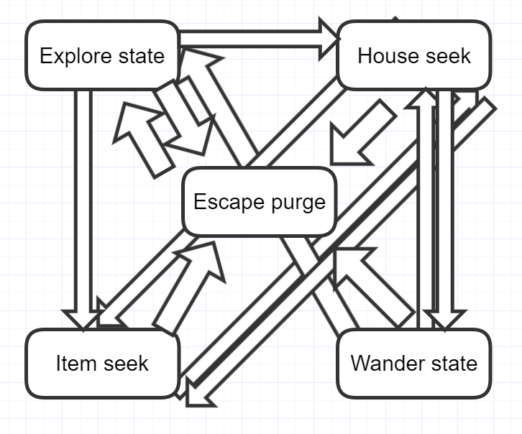
Decision Making
Shooting is handeld outside the FSM

Slide 3
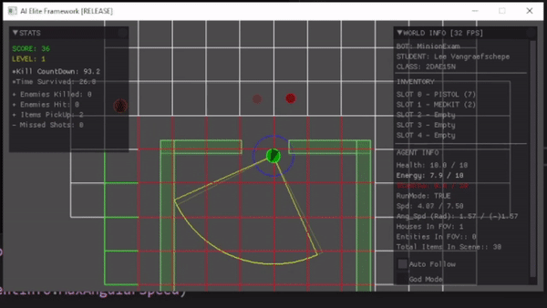
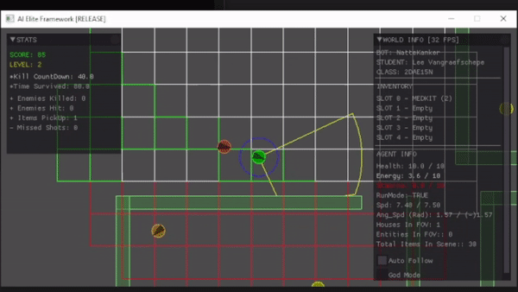
Enemy handling
Aiming
Ignoring

Slide 4
Inventory
Class inventory
Eat: energy < 1 or found extra food
Heal: hp < 8 or found extra medkit
Weapon: Ammo > current
Other: Destroy

Slide 5
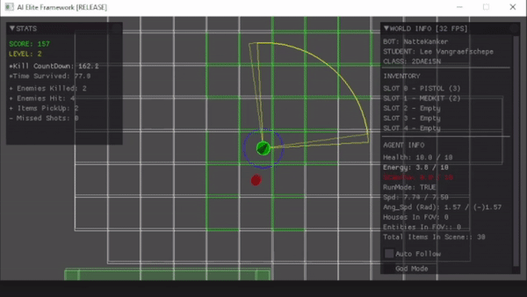
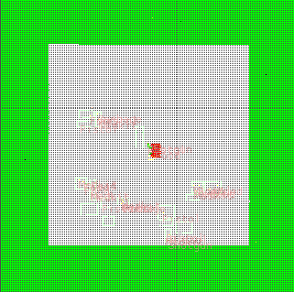
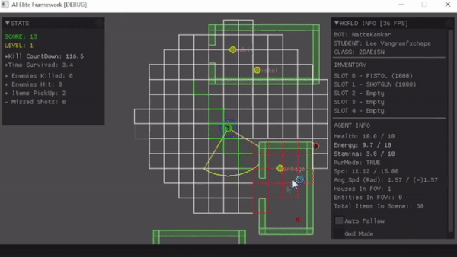
Movement & exploration

Slide 6
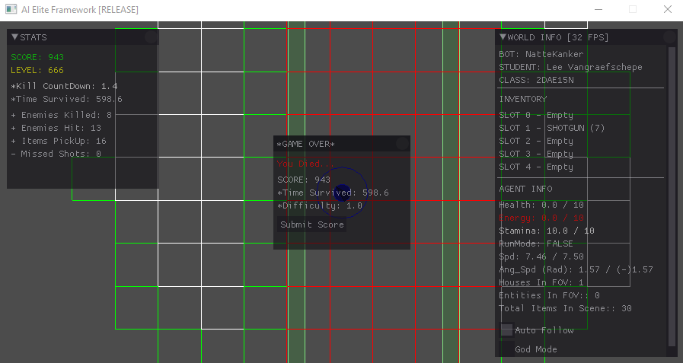
High Score

